Slide 1
UNIT 6
File Organization

Slide 2
File Organization
The File is a collection of records. Using the primary key, we can access the records. The type and frequency of access can be determined by the type of file organization which was used for a given set of records.
File organization is a logical relationship among various records. This method defines how file records are mapped onto disk blocks.
File organization is used to describe the way in which the records are stored in terms of blocks, and the blocks are placed on the storage medium.

Slide 3
Objective of file organization
It contains an optimal selection of records, i.e., records can be selected as fast as possible.
To perform insert, delete or update transaction on the records should be quick and easy.
The duplicate records cannot be induced as a result of insert, update or delete.
For the minimal cost of storage, records should be stored efficiently.

Slide 4
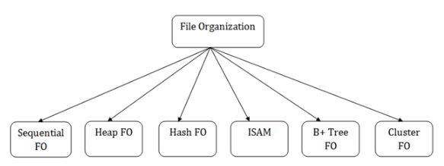
Types of file organization

Slide 5
1. Sequential File Organization
This method is the easiest method for file organization. In this method, files are stored sequentially.
This method can be implemented in two ways:
Pile file method
Sorted file method

Slide 6
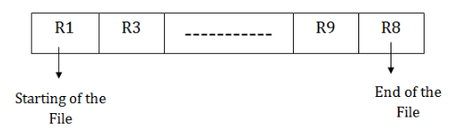
Pile File Method
It is a quite simple method. In this method, we store the record in a sequence, i.e., one after another. Here, the record will be inserted in the order in which they are inserted into tables.
In case of updating or deleting of any record, the record will be searched in the memory blocks. When it is found, then it will be marked for deleting, and the new record is inserted.

Slide 7
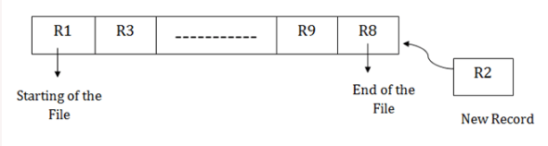
Insertion of the new record
Suppose we have four records R1, R3 and so on upto R9 and R8 in a sequence. Hence, records are nothing but a row in the table. Suppose we want to insert a new record R2 in the sequence, then it will be placed at the end of the file. Here, records are nothing but a row in any table.

Slide 8
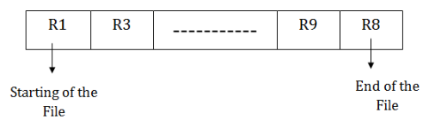
Sorted File Method
In this method, the new record is always inserted at the file's end, and then it will sort the sequence in ascending or descending order. Sorting of records is based on any primary key or any other key.
In the case of modification of any record, it will update the record and then sort the file, and lastly, the updated record is placed in the right place.

Slide 9
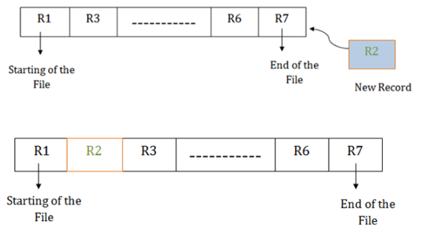
Insertion of the new record
Suppose there is a preexisting sorted sequence of four records R1, R3 and so on upto R6 and R7. Suppose a new record R2 has to be inserted in the sequence, then it will be inserted at the end of the file, and then it will sort the sequence.

Slide 10
Pros of sequential file organization
It contains a fast and efficient method for the huge amount of data.
In this method, files can be easily stored in cheaper storage mechanism like magnetic tapes.
It is simple in design. It requires no much effort to store the data.
Cons of sequential file organization
It will waste time as we cannot jump on a particular record that is required but we have to move sequentially which takes our time.
Sorted file method takes more time and space for sorting the records.

Slide 11
2. Heap file organization
In heap file organization, the records are inserted at the file's end. When the records are inserted, it doesn't require the sorting and ordering of records.
When the data block is full, the new record is stored in some other block. This new data block need not to be the very next data block, but it can select any data block in the memory to store new records. The heap file is also known as an unordered file.
In the file, every record has a unique id, and every page in a file is of the same size. It is the DBMS responsibility to store and manage the new records.

Slide 12
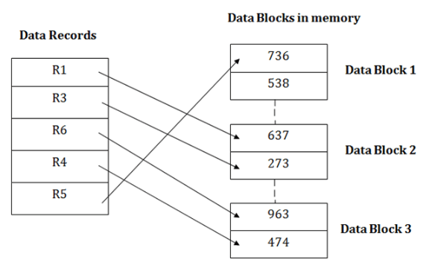
Example

Slide 13
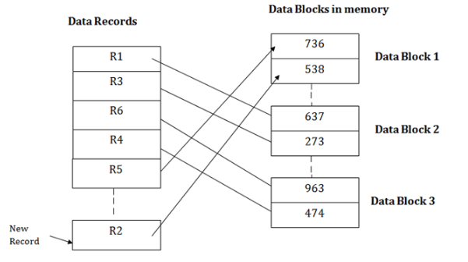
Insertion of a new record
Suppose we have five records R1, R3, R6, R4 and R5 in a heap and suppose we want to insert a new record R2 in a heap. If the data block 3 is full then it will be inserted in any of the database selected by the DBMS, let's say data block 1.

Slide 14
If we want to search, update or delete the data in heap file organization, then we need to traverse the data from staring of the file till we get the requested record.
If the database is very large then searching, updating or deleting of record will be time-consuming because there is no sorting or ordering of records.
In the heap file organization, we need to check all the data until we get the requested record.

Slide 15
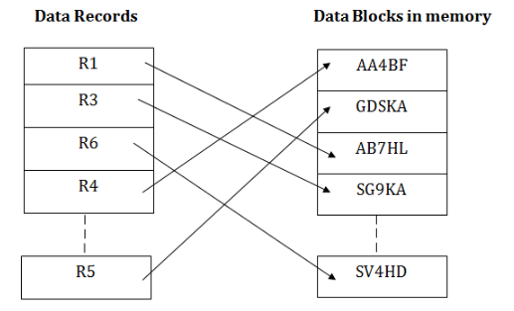
3. Hash File Organization
Hash File Organization uses the computation of hash function on some fields of the records. The hash function's output determines the location of disk block where the records are to be placed.

Slide 16
When a record has to be received using the hash key columns, then the address is generated, and the whole record is retrieved using that address. In the same way, when a new record has to be inserted, then the address is generated using the hash key and record is directly inserted. The same process is applied in the case of delete and update.
In this method, there is no effort for searching and sorting the entire file. In this method, each record will be stored randomly in the memory.

Slide 17
